Slide 1
Divide and Conquer 2
CS240 Spring 2024
Rui Fan

Slide 2
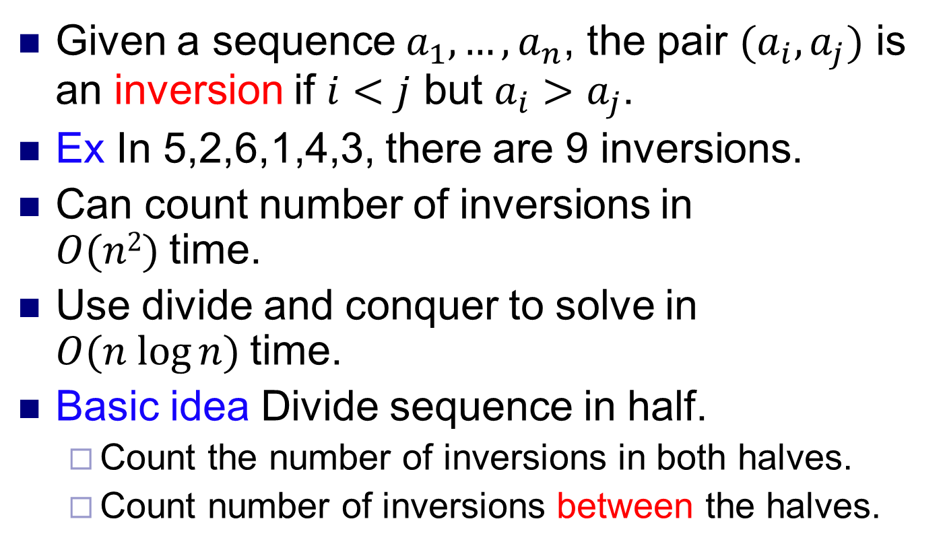
Counting inversions
Given a sequence $a_{1},…, a_{n}$, the pair $(a_{i},a_{j})$ is an inversion if $i<j$ but $a_{i}>a_{j}$.
Ex In 5,2,6,1,4,3, there are 9 inversions.
Can count number of inversions in $O(n2)$time.
Use divide and conquer to solve in $O(n log⁡n)$time.
Basic idea Divide sequence in half.
Count the number of inversions in both halves.
Count number of inversions between the halves.

Slide 3
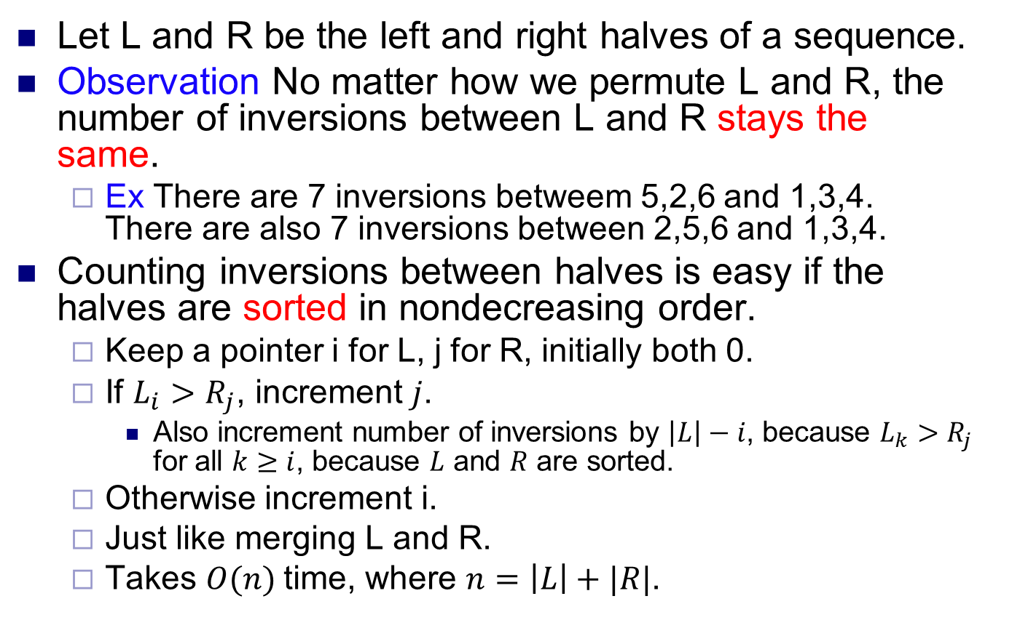
Counting inversions
Let L and R be the left and right halves of a sequence.
Observation No matter how we permute L and R, the number of inversions between L and R stays the same.
Ex There are 7 inversions betweem 5,2,6 and 1,3,4. There are also 7 inversions between 2,5,6 and 1,3,4.
Counting inversions between halves is easy if the halves are sorted in nondecreasing order.
Keep a pointer i for L, j for R, initially both 0.
If $L_{i}>R_{j}$, increment $j$.
Also increment number of inversions by $\left|L\right|−i$, because $L_{k}>R_{j}$ for all $k≥i$, because $L$ and $R$ are sorted.
Otherwise increment i.
Just like merging L and R.
Takes $O(n)$time, where $n=\left|L\right|+|R|$.

Slide 4

Counting Inversions: Divide-and-Conquer
Divide-and-conquer.
Divide: separate list into two pieces.
Conquer: recursively count inversions in each half.
Combine: count inversions where $ai$and $aj$ are in different halves, and return sum of three quantities.
1
5
4
8
10
2
6
9
12
11
3
7
Divide: O(1).
1
5
4
8
10
2
6
9
12
11
3
7
Conquer: 2T(n / 2)
5 blue-blue inversions
8 green-green inversions
9 blue-green inversions
5-3, 4-3, 8-6, 8-3, 8-7, 10-6, 10-9, 10-3, 10-7
Combine: ???
Total = 5 + 8 + 9 = 22.

Slide 5
Merge and Count
Merge and count step.
Given two sorted halves, count number of inversions where a_{i} and a_{j} are in different halves.
Combine two sorted halves into sorted whole.
i = 6
3
7
10
14
18
19
2
11
16
17
23
25
two sorted halves
auxiliary array
Total:

Slide 6
Merge and Count
Merge and count step.
Given two sorted halves, count number of inversions where a_{i} and a_{j} are in different halves.
Combine two sorted halves into sorted whole.
i = 6
3
7
10
14
18
19
2
11
16
17
23
25
two sorted halves
6
2
auxiliary array
Total: 6

Slide 7
Merge and Count
Merge and count step.
Given two sorted halves, count number of inversions where a_{i} and a_{j} are in different halves.
Combine two sorted halves into sorted whole.
i = 6
3
7
10
14
18
19
2
11
16
17
23
25
two sorted halves
6
2
auxiliary array
Total: 6

Slide 8
Merge and Count
Merge and count step.
Given two sorted halves, count number of inversions where a_{i} and a_{j} are in different halves.
Combine two sorted halves into sorted whole.
i = 6
3
7
10
14
18
19
2
11
16
17
23
25
two sorted halves
6
2
3
auxiliary array
Total: 6

Slide 9
Merge and Count
Merge and count step.
Given two sorted halves, count number of inversions where a_{i} and a_{j} are in different halves.
Combine two sorted halves into sorted whole.
i = 5
3
7
10
14
18
19
2
11
16
17
23
25
two sorted halves
6
2
3
auxiliary array
Total: 6

Slide 10
Merge and Count
Merge and count step.
Given two sorted halves, count number of inversions where a_{i} and a_{j} are in different halves.
Combine two sorted halves into sorted whole.
i = 5
3
7
10
14
18
19
2
11
16
17
23
25
two sorted halves
6
2
3
7
auxiliary array
Total: 6

Slide 11
Merge and Count
Merge and count step.
Given two sorted halves, count number of inversions where a_{i} and a_{j} are in different halves.
Combine two sorted halves into sorted whole.
i = 4
3
7
10
14
18
19
2
11
16
17
23
25
two sorted halves
6
2
3
7
auxiliary array
Total: 6

Slide 12
Merge and Count
Merge and count step.
Given two sorted halves, count number of inversions where a_{i} and a_{j} are in different halves.
Combine two sorted halves into sorted whole.
i = 4
3
7
10
14
18
19
2
11
16
17
23
25
two sorted halves
6
2
3
7
10
auxiliary array
Total: 6

Slide 13
Merge and Count
Merge and count step.
Given two sorted halves, count number of inversions where a_{i} and a_{j} are in different halves.
Combine two sorted halves into sorted whole.
i = 3
3
7
10
14
18
19
2
11
16
17
23
25
two sorted halves
6
2
3
7
10
auxiliary array
Total: 6

Slide 14
Merge and Count
Merge and count step.
Given two sorted halves, count number of inversions where a_{i} and a_{j} are in different halves.
Combine two sorted halves into sorted whole.
i = 3
3
7
10
14
18
19
2
11
16
17
23
25
two sorted halves
6
3
2
3
7
10
11
auxiliary array
Total: 6 + 3

Slide 15
Merge and Count
Merge and count step.
Given two sorted halves, count number of inversions where a_{i} and a_{j} are in different halves.
Combine two sorted halves into sorted whole.
i = 3
3
7
10
14
18
19
2
11
16
17
23
25
two sorted halves
6
3
2
3
7
10
11
auxiliary array
Total: 6 + 3

Slide 16
Merge and Count
Merge and count step.
Given two sorted halves, count number of inversions where a_{i} and a_{j} are in different halves.
Combine two sorted halves into sorted whole.
i = 3
3
7
10
14
18
19
2
11
16
17
23
25
two sorted halves
6
3
2
3
7
10
11
14
auxiliary array
Total: 6 + 3

Slide 17
Merge and Count
Merge and count step.
Given two sorted halves, count number of inversions where a_{i} and a_{j} are in different halves.
Combine two sorted halves into sorted whole.
i = 2
3
7
10
14
18
19
2
11
16
17
23
25
two sorted halves
6
3
2
3
7
10
11
14
auxiliary array
Total: 6 + 3

Slide 18
Merge and Count
Merge and count step.
Given two sorted halves, count number of inversions where a_{i} and a_{j} are in different halves.
Combine two sorted halves into sorted whole.
i = 2
3
7
10
14
18
19
2
11
16
17
23
25
two sorted halves
6
3
2
2
3
7
10
11
14
16
auxiliary array
Total: 6 + 3 + 2

Slide 19
Merge and Count
Merge and count step.
Given two sorted halves, count number of inversions where a_{i} and a_{j} are in different halves.
Combine two sorted halves into sorted whole.
i = 2
3
7
10
14
18
19
2
11
16
17
23
25
two sorted halves
6
3
2
2
3
7
10
11
14
16
auxiliary array
Total: 6 + 3 + 2

Slide 20
Merge and Count
Merge and count step.
Given two sorted halves, count number of inversions where a_{i} and a_{j} are in different halves.
Combine two sorted halves into sorted whole.
i = 2
3
7
10
14
18
19
2
11
16
17
23
25
two sorted halves
6
3
2
2
2
3
7
10
11
14
16
17
auxiliary array
Total: 6 + 3 + 2 + 2

Slide 21
Merge and Count
Merge and count step.
Given two sorted halves, count number of inversions where a_{i} and a_{j} are in different halves.
Combine two sorted halves into sorted whole.
i = 2
3
7
10
14
18
19
2
11
16
17
23
25
two sorted halves
6
3
2
2
2
3
7
10
11
14
16
17
auxiliary array
Total: 6 + 3 + 2 + 2

Slide 22
Merge and Count
Merge and count step.
Given two sorted halves, count number of inversions where a_{i} and a_{j} are in different halves.
Combine two sorted halves into sorted whole.
i = 2
3
7
10
14
18
19
2
11
16
17
23
25
two sorted halves
6
3
2
2
2
3
7
10
11
14
16
17
18
auxiliary array
Total: 6 + 3 + 2 + 2

Slide 23
Merge and Count
Merge and count step.
Given two sorted halves, count number of inversions where a_{i} and a_{j} are in different halves.
Combine two sorted halves into sorted whole.
i = 1
3
7
10
14
18
19
2
11
16
17
23
25
two sorted halves
6
3
2
2
2
3
7
10
11
14
16
17
18
auxiliary array
Total: 6 + 3 + 2 + 2

Slide 24
Merge and Count
Merge and count step.
Given two sorted halves, count number of inversions where a_{i} and a_{j} are in different halves.
Combine two sorted halves into sorted whole.
i = 1
3
7
10
14
18
19
2
11
16
17
23
25
two sorted halves
6
3
2
2
2
3
7
10
11
14
16
17
18
19
auxiliary array
Total: 6 + 3 + 2 + 2

Slide 25
Merge and Count
Merge and count step.
Given two sorted halves, count number of inversions where a_{i} and a_{j} are in different halves.
Combine two sorted halves into sorted whole.
first half exhausted
i = 0
3
7
10
14
18
19
2
11
16
17
23
25
two sorted halves
6
3
2
2
2
3
7
10
11
14
16
17
18
19
auxiliary array
Total: 6 + 3 + 2 + 2

Slide 26
Merge and Count
Merge and count step.
Given two sorted halves, count number of inversions where a_{i} and a_{j} are in different halves.
Combine two sorted halves into sorted whole.
i = 0
3
7
10
14
18
19
2
11
16
17
23
25
two sorted halves
6
3
2
2
0
2
3
7
10
11
14
16
17
18
19
23
auxiliary array
Total: 6 + 3 + 2 + 2 + 0

Slide 27
Merge and Count
Merge and count step.
Given two sorted halves, count number of inversions where a_{i} and a_{j} are in different halves.
Combine two sorted halves into sorted whole.
i = 0
3
7
10
14
18
19
2
11
16
17
23
25
two sorted halves
6
3
2
2
0
2
3
7
10
11
14
16
17
18
19
23
auxiliary array
Total: 6 + 3 + 2 + 2 + 0

Slide 28
Merge and Count
Merge and count step.
Given two sorted halves, count number of inversions where a_{i} and a_{j} are in different halves.
Combine two sorted halves into sorted whole.
i = 0
3
7
10
14
18
19
2
11
16
17
23
25
two sorted halves
6
3
2
2
0
0
2
3
7
10
11
14
16
17
18
19
23
25
auxiliary array
Total: 6 + 3 + 2 + 2 + 0 + 0

Slide 29
Merge and Count
Merge and count step.
Given two sorted halves, count number of inversions where a_{i} and a_{j} are in different halves.
Combine two sorted halves into sorted whole.
i = 0
3
7
10
14
18
19
2
11
16
17
23
25
two sorted halves
6
3
2
2
0
0
2
3
7
10
11
14
16
17
18
19
23
25
auxiliary array
Total: 6 + 3 + 2 + 2 + 0 + 0 = 13

Slide 30
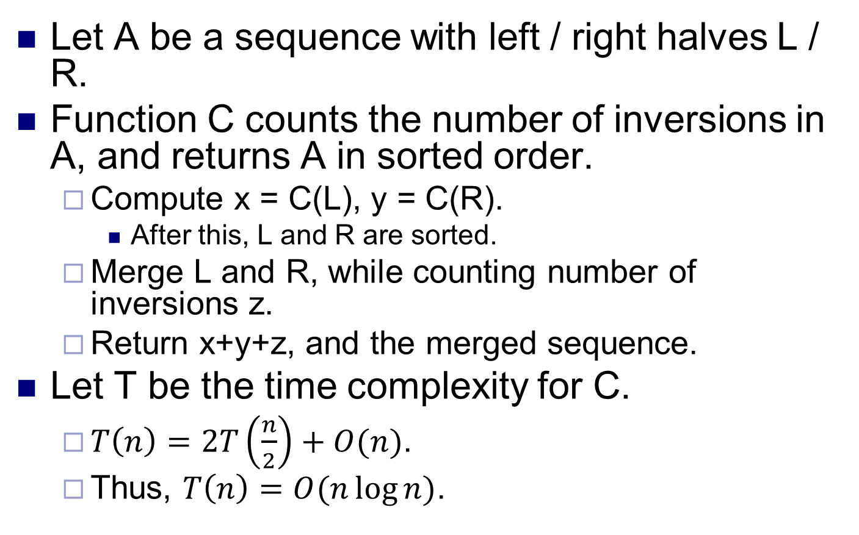
Counting inversions
Let A be a sequence with left / right halves L / R.
Function C counts the number of inversions in A, and returns A in sorted order.
Compute x = C(L), y = C(R).
After this, L and R are sorted.
Merge L and R, while counting number of inversions z.
Return x+y+z, and the merged sequence.
Let T be the time complexity for C.
$T\left(n\right)=2T\left(\frac{n}{2}\right)+O(n)$.
Thus, $T\left(n\right)=O(n\log{n)}$.

Slide 31
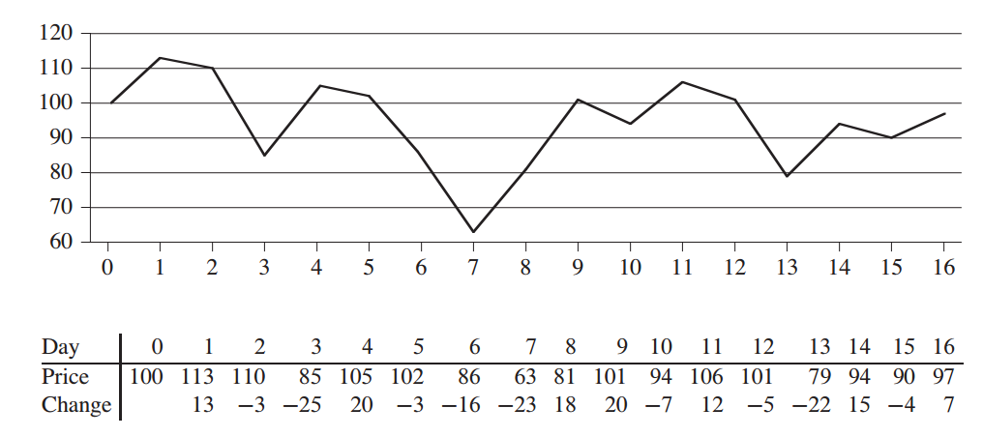
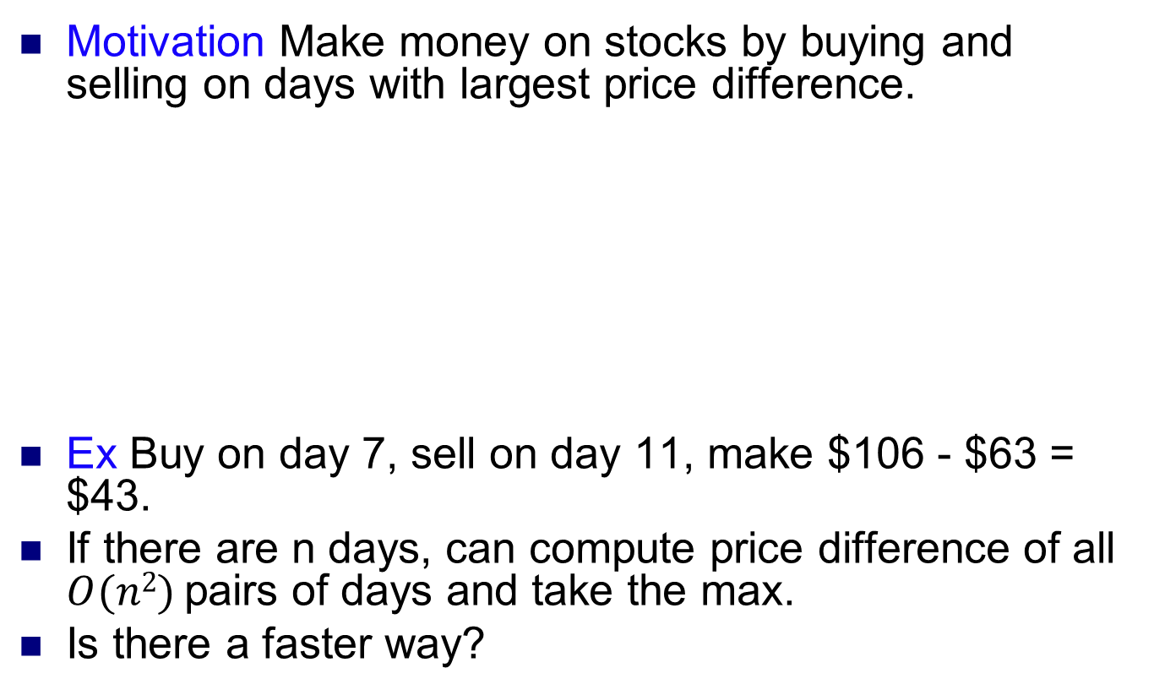
Maximum subarray
Motivation Make money on stocks by buying and selling on days with largest price difference.
Ex Buy on day 7, sell on day 11, make $106 - $63 = $43.
If there are n days, can compute price difference of all $O(n2)$pairs of days and take the max.
Is there a faster way?
Source: Introduction to Algorithms
Cormen et al

Slide 32
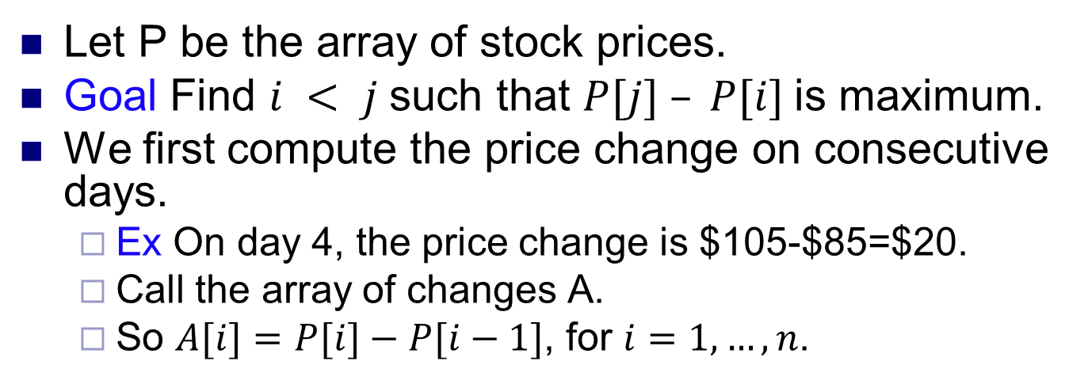
Maximum subarray
Let P be the array of stock prices.
Goal Find $i < j$such that $P[j] – P[i]$is maximum.
We first compute the price change on consecutive days.
Ex On day 4, the price change is $105-$85=$20.
Call the array of changes A.
So $A[i]=P[i]−P[i−1]$, for $i=1,…,n$.

Slide 33
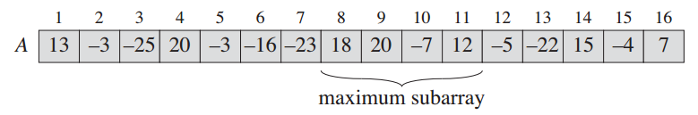
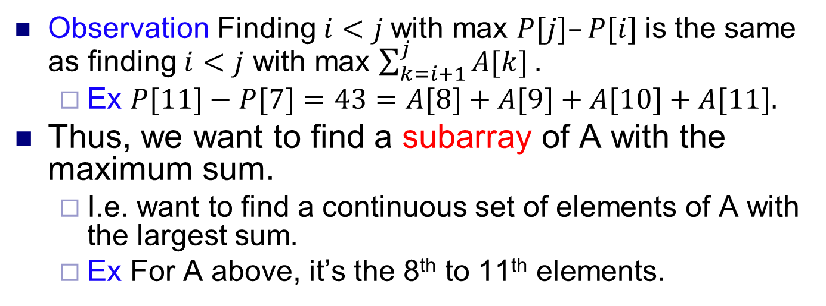
Maximum subarray
Observation Finding $i<j$with max $P[j]–P[i]$is the same as finding $i<j$ with max $\sum_{k=i+1}^{j}{A[k]}\text{.}$
Ex $P[11]−P[7]=43=A[8]+A[9]+A[10]+A[11].$
Thus, we want to find a subarray of A with the maximum sum.
I.e. want to find a continuous set of elements of A with the largest sum.
Ex For A above, it’s the 8th to 11th elements.

Slide 34
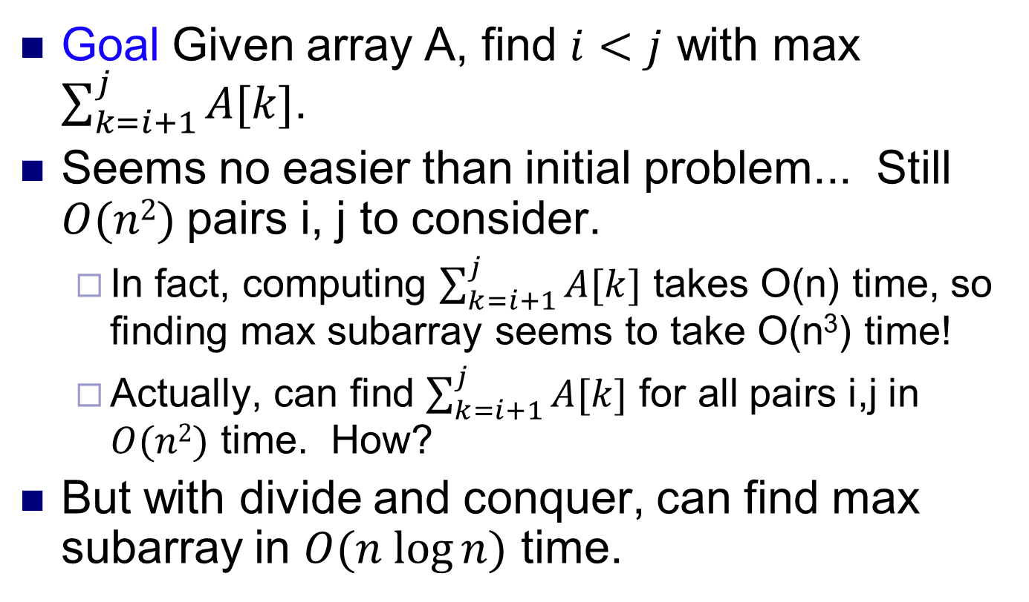
Maximum subarray
Goal Given array A, find $i<j$ with max $\sum_{k=i+1}^{j}{A[k]}$.
Seems no easier than initial problem... Still $O(n2)$pairs i, j to consider.
In fact, computing $\sum_{k=i+1}^{j}{A[k]}$ takes O(n) time, so finding max subarray seems to take O(n³) time!
Actually, can find $\sum_{k=i+1}^{j}{A[k]}$ for all pairs i,j in $O(n2)$ time. How?
But with divide and conquer, can find max subarray in $O(n log⁡n)$ time.

Slide 35
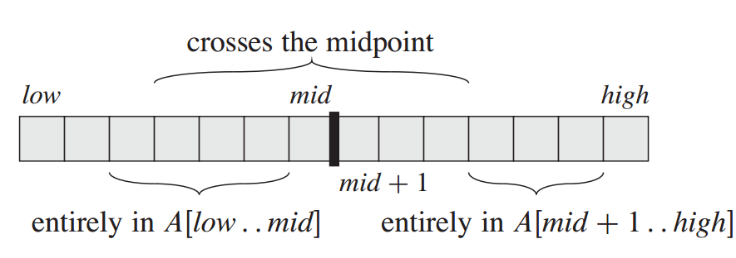
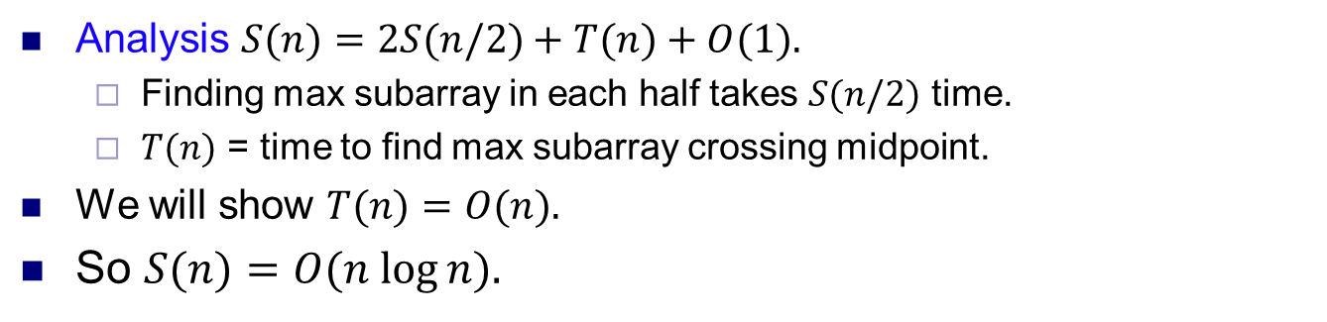
A divide and conquer algorithm
Observation
Algorithm
Divide A down the middle. Then a max subarray of A either
Lies entirely in the left half.
Lies entirely in the right half.
Crosses the midpoint.
Break A into left and right halves.
Compute the max subarrays in each half.
Compute the max subarray crossing the midpoint.
Return max of these three subarrays.
Analysis $S(n)=2S(n/2)+T(n)+O(1).$
Finding max subarray in each half takes $S(n/2)$ time.
$T(n)$ = time to find max subarray crossing midpoint.
We will show $T(n)=O(n).$
So $S(n)=O(n log⁡n).$

Slide 36
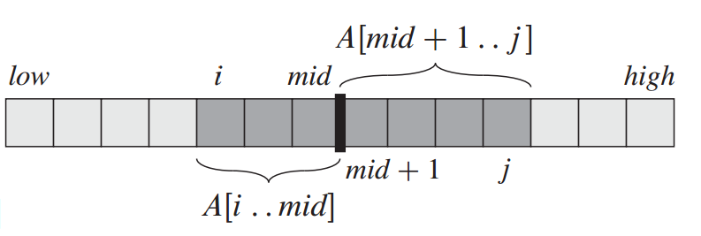
Max crossing subarray
Goal Find max subarray crossing the midpoint.
Solution Find the max leftwards subarray from the midpoint.
I.e. find a subarray containing the midpoint and lying to the left, that has the max sum.
Also find the max rightwards subarray from the midpoint.
Combine them and return this.
Ex A = [3,2,-8,1,6,7,-4,2,8,2,-4,1,-2, 3,1].
Max leftwards subarray from 2 is [1,6,7,-4,2].
Max rightwards subarray from 2 is [2,8,2].
Max crossing subarray is [1,6,7,-4,2,8,2].

Slide 37
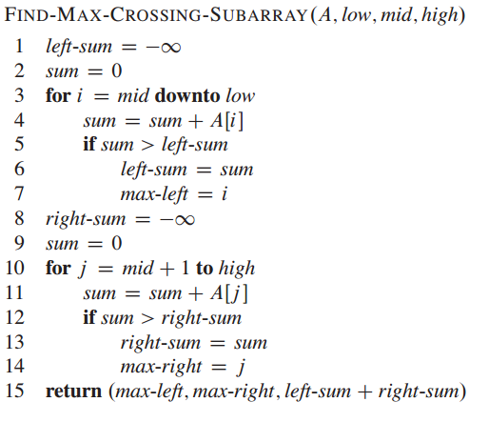
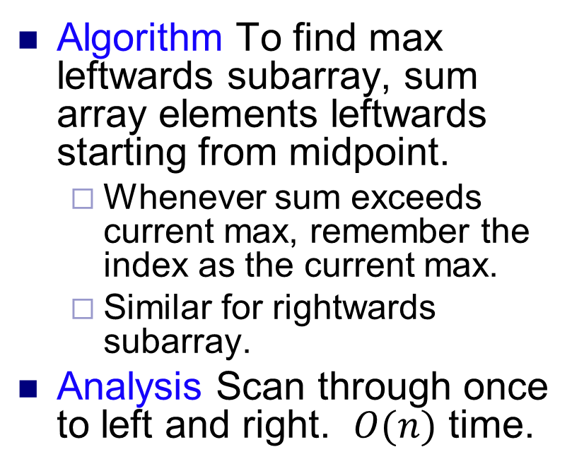
Max crossing subarray
Algorithm To find max leftwards subarray, sum array elements leftwards starting from midpoint.
Whenever sum exceeds current max, remember the index as the current max.
Similar for rightwards subarray.
Analysis Scan through once to left and right. $O(n)$ time.

Slide 38
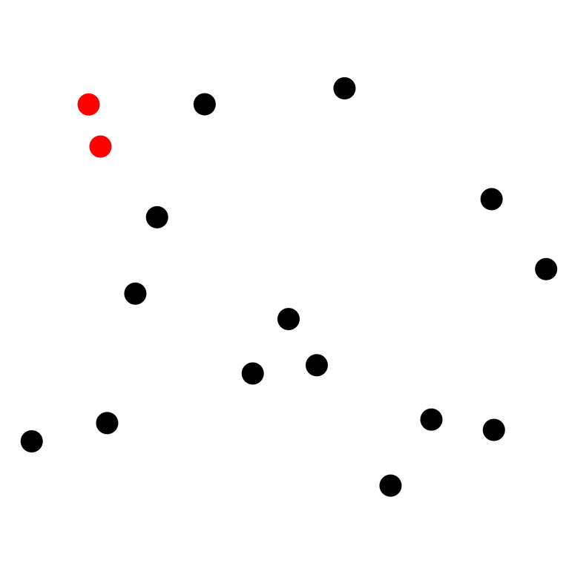
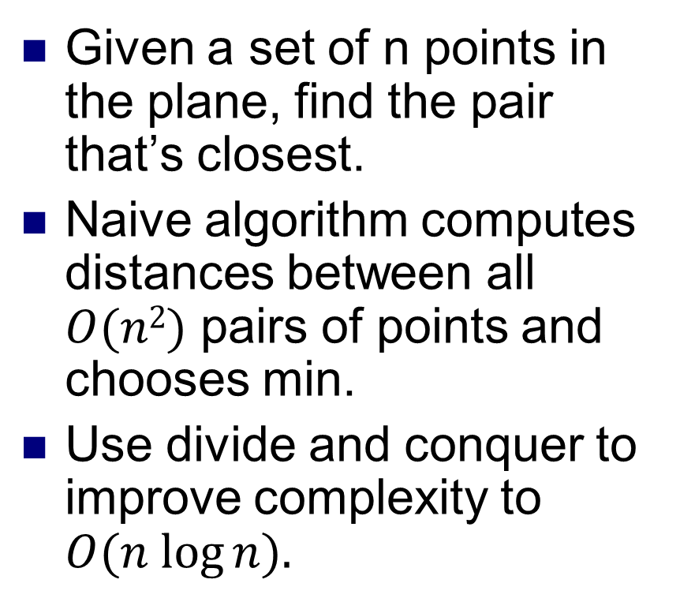
Closest point pair
Given a set of n points in the plane, find the pair that’s closest.
Naive algorithm computes distances between all $O(n2)$ pairs of points and chooses min.
Use divide and conquer to improve complexity to $O(n log⁡n).$

Slide 39
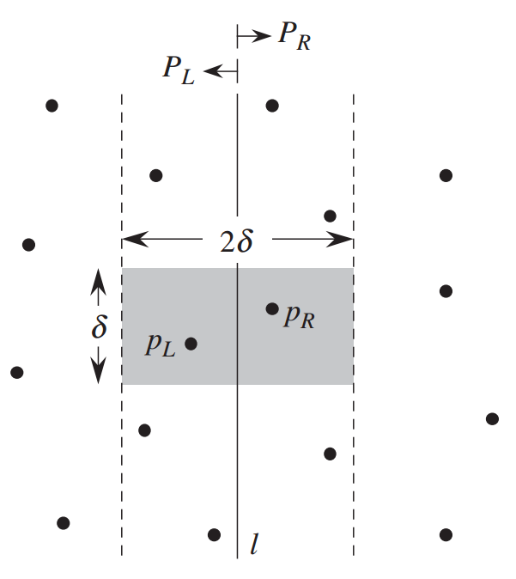
Closest point pair
Split the points evenly using a vertical line, i.e. half the points lie on the left and half on the right.
Observation The closest pair of points either
Both lie in the left half
Both lie in the right half, or
Straddles the line, i.e. one point on each side.
This suggests the following algorithm.

Slide 40
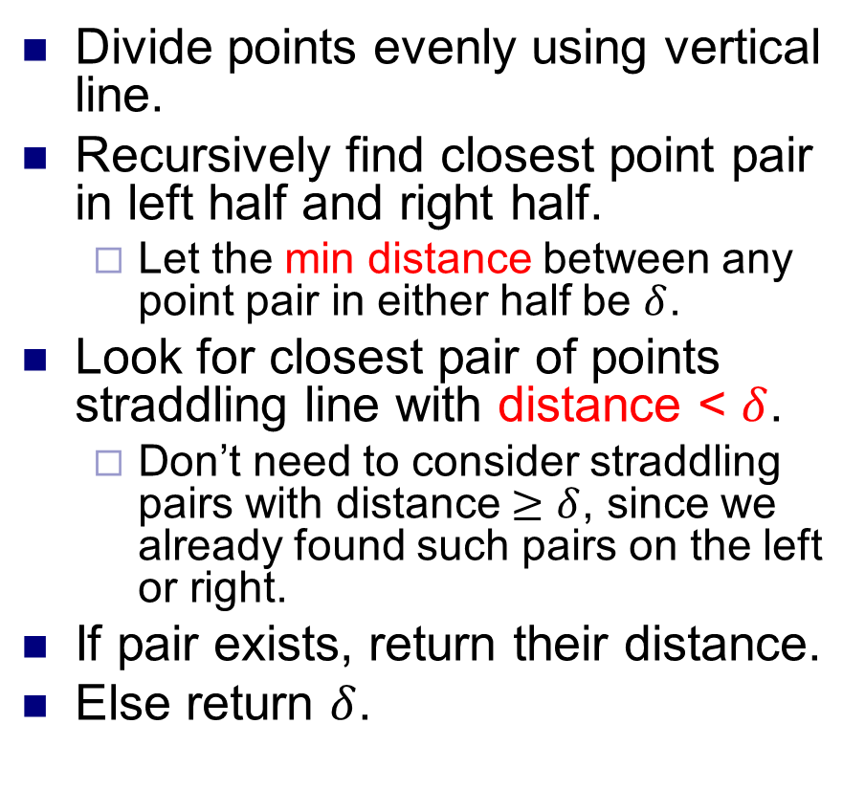
Closest point pair
Divide points evenly using vertical line.
Recursively find closest point pair in left half and right half.
Let the min distance between any point pair in either half be $δ$.
Look for closest pair of points straddling line with distance < $δ$.
Don’t need to consider straddling pairs with distance $≥δ$, since we already found such pairs on the left or right.
If pair exists, return their distance.
Else return $δ$.

Slide 41
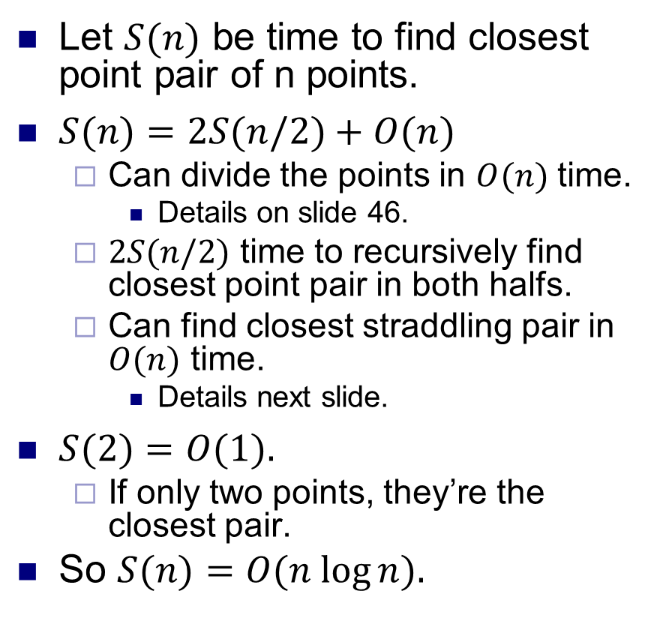
Algorithm analysis
Let $S(n)$ be time to find closest point pair of n points.
$S(n)=2S(n/2)+O(n)$
Can divide the points in $O(n)$ time.
Details on slide 46.
$2S(n/2)$ time to recursively find closest point pair in both halfs.
Can find closest straddling pair in $O(n)$ time.
Details next slide.
$S(2)=O(1).$
If only two points, they’re the closest pair.
So $S(n)=O(n log⁡n).$
Divide the points evenly.
Recursively find closest pair on left and right.
Find closest straddling pair.
Return the min of the three.

Slide 42
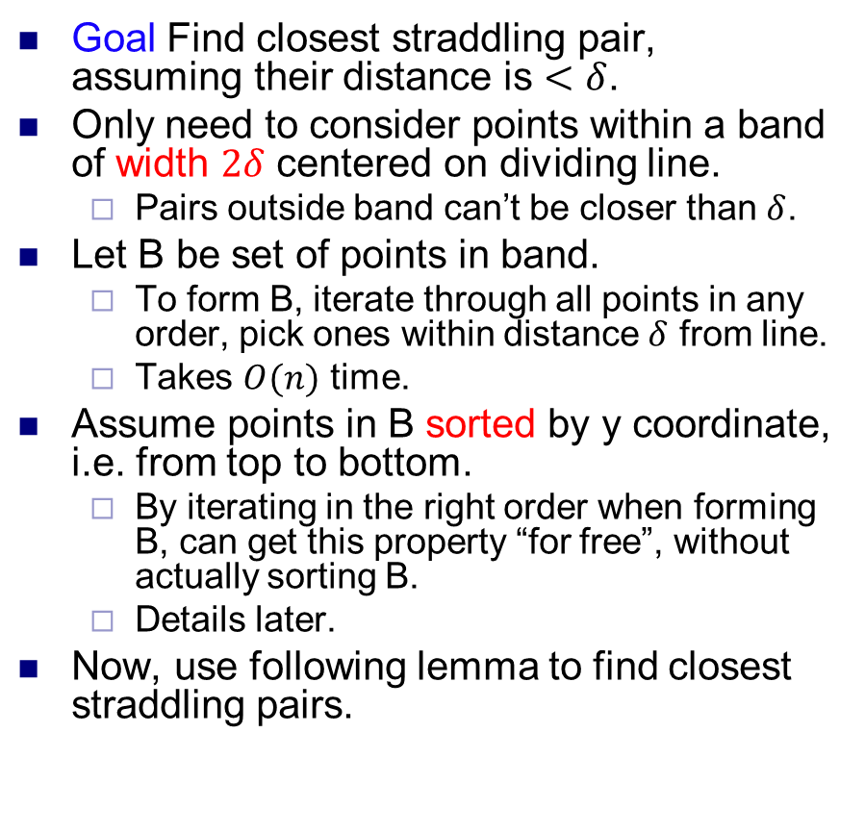
Closest straddling point pair
Goal Find closest straddling pair, assuming their distance is $<δ$.
Only need to consider points within a band of width $2δ$ centered on dividing line.
Pairs outside band can’t be closer than $δ$.
Let B be set of points in band.
To form B, iterate through all points in any order, pick ones within distance $δ$ from line.
Takes $O(n)$ time.
Assume points in B sorted by y coordinate, i.e. from top to bottom.
By iterating in the right order when forming B, can get this property “for free”, without actually sorting B.
Details later.
Now, use following lemma to find closest straddling pairs.
2δ band around divding line

Slide 43
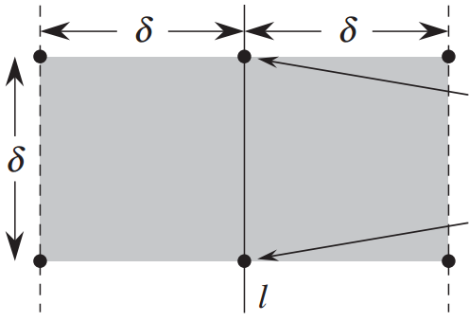
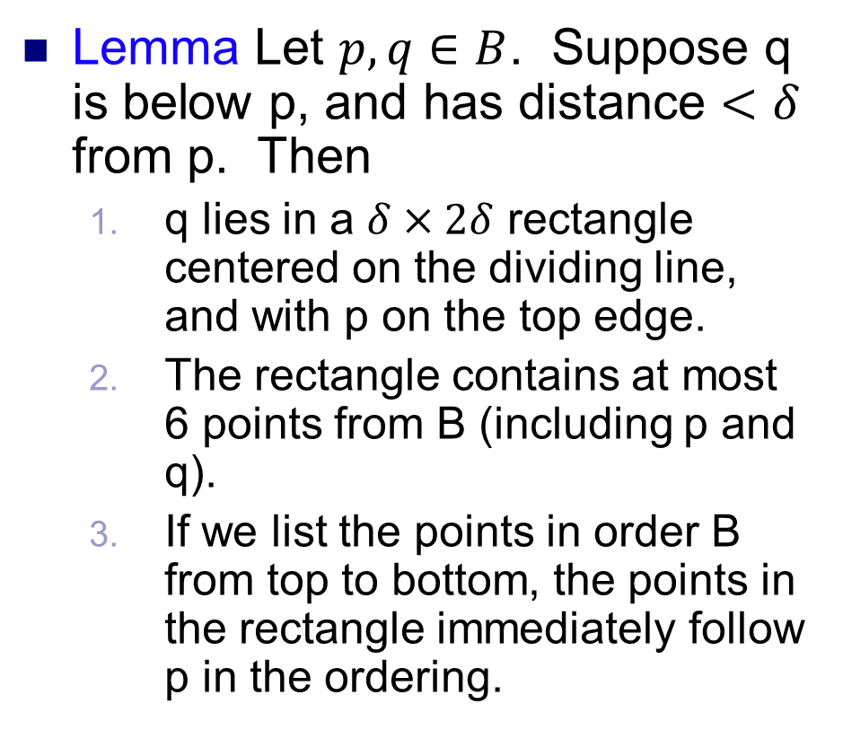
Sparsity lemma
Lemma Let $p, q∈B$. Suppose q is below p, and has distance $<δ$ from p. Then
q lies in a $δ×2δ$ rectangle centered on the dividing line, and with p on the top edge.
The rectangle contains at most 6 points from B (including p and q).
If we list the points in order B from top to bottom, the points in the rectangle immediately follow p in the ordering.
p
q

Slide 44
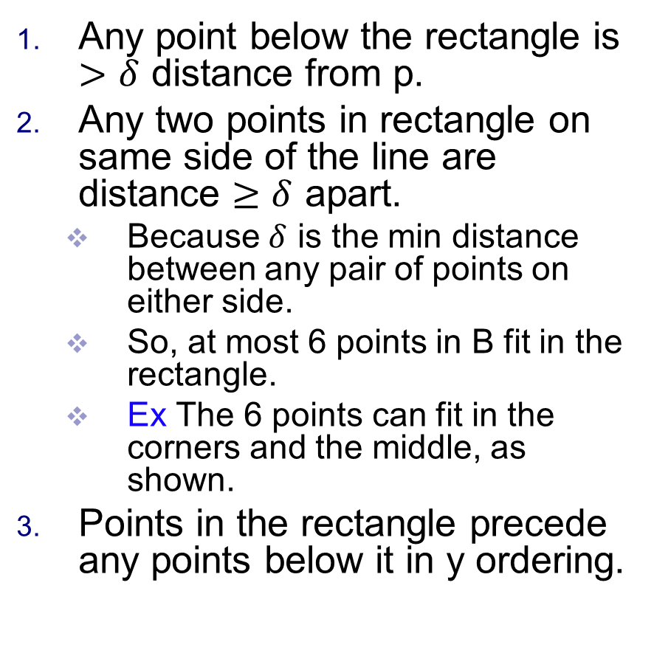
Sparsity lemma proof
Any point below the rectangle is $>δ$ distance from p.
Any two points in rectangle on same side of the line are distance $≥δ$ apart.
Because $δ$ is the min distance between any pair of points on either side.
So, at most 6 points in B fit in the rectangle.
Ex The 6 points can fit in the corners and the middle, as shown.
Points in the rectangle precede any points below it in y ordering.
p
q

Slide 45
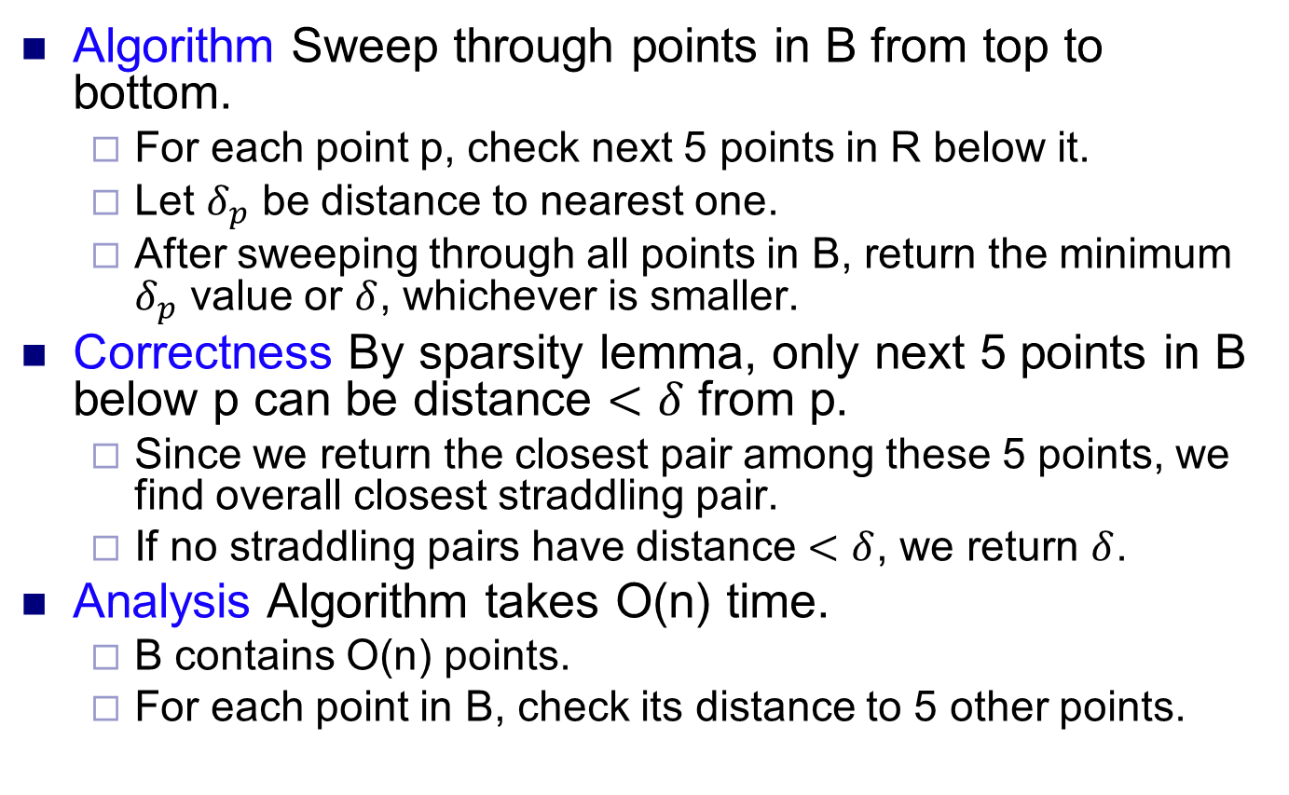
Closest straddling point pair
Algorithm Sweep through points in B from top to bottom.
For each point p, check next 5 points in R below it.
Let $δ_{p}$ be distance to nearest one.
After sweeping through all points in B, return the minimum $δ_{p}$ value or $δ$, whichever is smaller.
Correctness By sparsity lemma, only next 5 points in B below p can be distance $<δ$ from p.
Since we return the closest pair among these 5 points, we find overall closest straddling pair.
If no straddling pairs have distance $<δ$, we return $δ$.
Analysis Algorithm takes O(n) time.
B contains O(n) points.
For each point in B, check its distance to 5 other points.

Slide 46
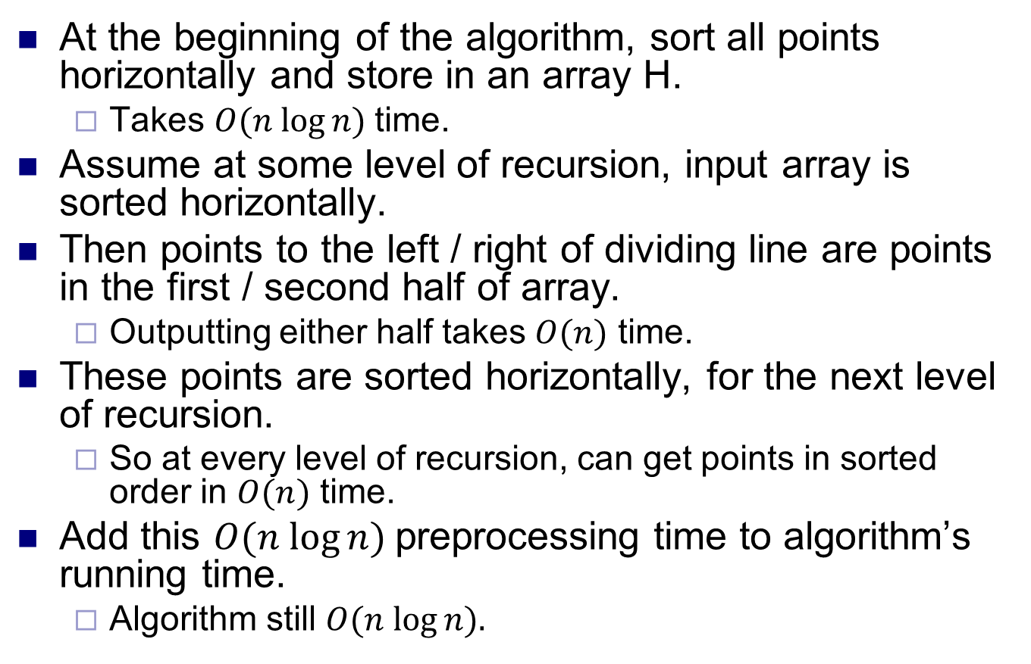
Dividing points evenly
At the beginning of the algorithm, sort all points horizontally and store in an array H.
Takes $O(n log⁡n)$time.
Assume at some level of recursion, input array is sorted horizontally.
Then points to the left / right of dividing line are points in the first / second half of array.
Outputting either half takes $O(n)$ time.
These points are sorted horizontally, for the next level of recursion.
So at every level of recursion, can get points in sorted order in $O(n)$ time.
Add this $O(n log⁡n)$preprocessing time to algorithm’s running time.
Algorithm still $O(n log⁡n).$

Slide 47
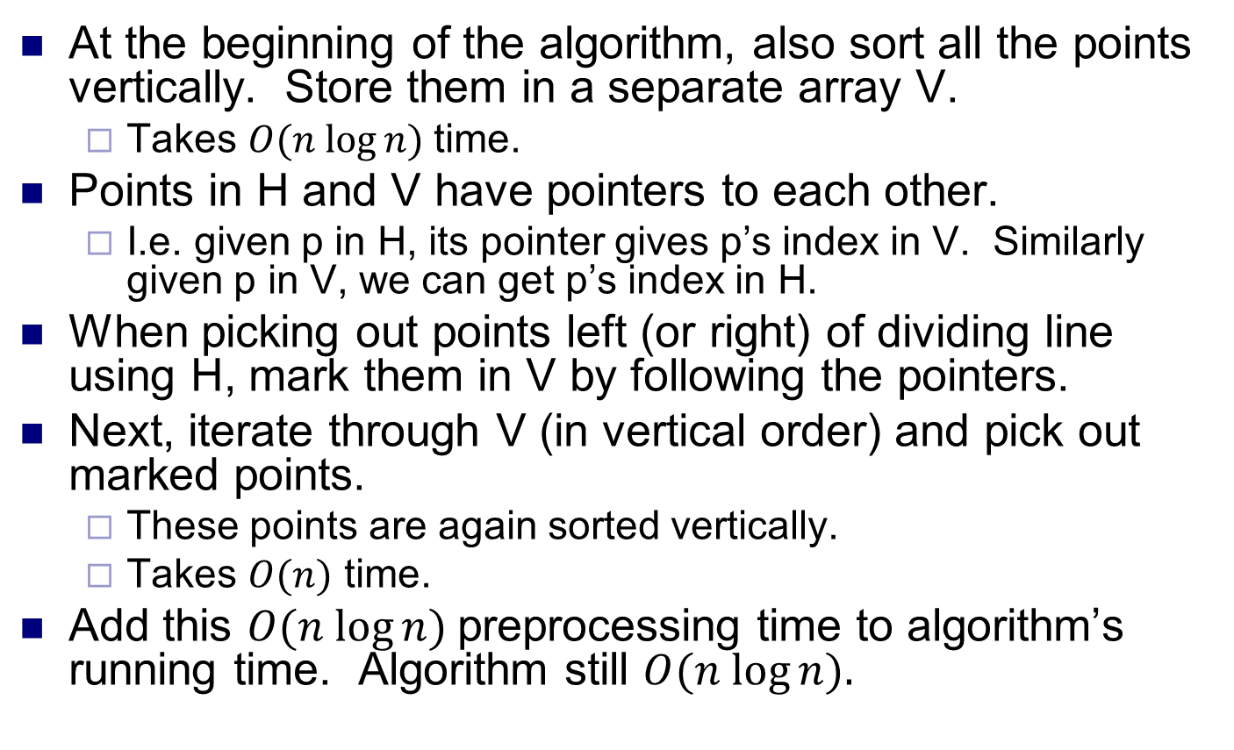
Sorting R points by y coordinate
At the beginning of the algorithm, also sort all the points vertically. Store them in a separate array V.
Takes $O(n log⁡n)$time.
Points in H and V have pointers to each other.
I.e. given p in H, its pointer gives p’s index in V. Similarly given p in V, we can get p’s index in H.
When picking out points left (or right) of dividing line using H, mark them in V by following the pointers.
Next, iterate through V (in vertical order) and pick out marked points.
These points are again sorted vertically.
Takes $O(n)$ time.
Add this $O(n log⁡n)$preprocessing time to algorithm’s running time. Algorithm still $O(n log⁡n).$

